Slide 1
How Do Ants Maintain Consensus in the Context of Changing Decisions?
Investigating Ants’ Sharp Turn During Collective Transport Using Simulation
Jooseok Lee & Sitong Lu
CSCI 5423 Project Presentation
Notes:
Presenter: Sitong Lu

Slide 2
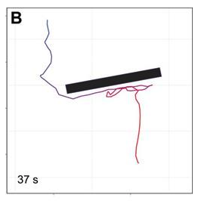
Motivation
Ants sometimes turn sharply during collective transport (Helen et al., 2016).
How? → Decision-making Mechanism behind this phenomenon
Sharp turn 1
Sharp turn 2
Figure 1. Sharp turns during collective transport
Notes:
Presenter: Sitong Lu
According to the paper we read previously, a group of ants could make a turn without hesitation during collective transport as shown in this figure.
We got interested into this phenomenon and are trying to find a decision-making mechanism behind this.
How do ants make sharp turn without hesitation

Slide 3
Consensus Formation - Related Work
Forming a consensus during collective decision-making is one of the most important aspects for group survival.
Various studies were conducted to explain how different kinds of animal groups come up with a consensus, resulting in numerous decision-making models.
Bayesian decision model, based on the number of others with the same choice, provides a unified rule for consensus formation in animal collectives (Arganda et al., 2012).
Notes:
Presenter: Sitong Lu
Forming a consensus during collective decision-making is one of the most important things for group survival.
Various studies were conducted to explain how animal groups form a consensus and many decision-making models were developed.
Arganda et al. built a Bayesian decision model to unify the previous works, which is our main referencing model for this project.
Forming a consensus during collective decision-making is one of the most important aspects for group survival. Various studies were conducted to explain how different kinds of animal groups come up with a consensus, resulting in numerous decision-making models.
A unified decision-making rule, where each individual makes a decision with Bayesian estimations based on the number of others with the same choice, was proposed to consolidate the previous efforts.
It was observed that Paratrechina longicornis ants can maintain a consensus not only when they are collectively transporting but also making a sharp turn in the presence of obstacles [1], which could not be effectively explained with the decision-making rule proposed in [2].

Slide 4
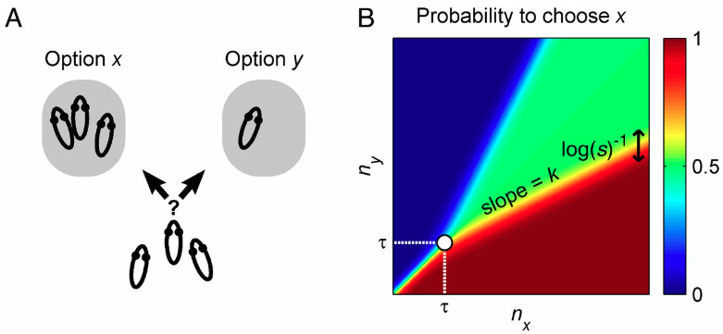
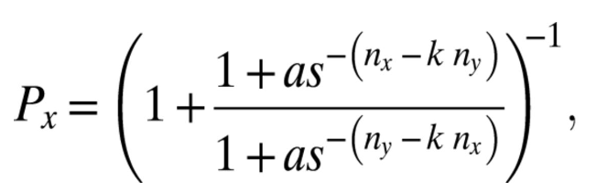
A Unified Rule for Consensus formation
The higher the number of individuals that chose option x (i.e., n_{x}), the higher the probability of choosing option x
Low number of individuals → Fast transition between preferring options
High number of individuals → Intermediate region (Green area)
Figure 2. Each individual’s probability of choosing option x
Figure 3. A general decision-making process in animal groups. (A) Probability of choosing option x depending on the number of individuals that chose option x (B).
Notes:
Presenter: Sitong Lu
This model basically states that the higher the number of individuals that choose one option in previous step, the higher to probability of choosing that option in the current step.
The figure on the right shows the probability of of choosing one option depending on the number of individuals that chose two options, namely nx and ny.
According to this model, an individual would rapidly change its decision if a group is small. On the other hand, it would take longer to change its decision if a group is large as shown in figure on the right.
A unified decision-making rule, where each individual makes a decision with Bayesian estimations based on the number of others with the same choice, was proposed to consolidate the previous efforts.

Slide 5
Problems with the existing work
The proposed decision model, however, COULD NOT effectively explain the phenomenon where ants make sharp turns maintaining a consensus.
It is highly likely that ants will continue to go to a direction if they reach the points where the probability of choosing the direction reaches near one.
Figure 4. Ants will continue to go to a direction if they reach the points where the probability of choosing the direction reaches near one.
Notes:
Presenter: Sitong Lu
This model, however, could not effectively explain the phenomenon we are interested in.
As shown in the figure, the decision of a group eventually ends up with majority votes in the end.

Slide 6
Project Concept
To explain this phenomena, we propose an extended decision-making model to explain sharp turns in the context of two options
Short-term memory
Decaying rate of preference
We test the effectiveness of proposed model using simulation
Number of sharp turns
Number of steps taken to form a consensus after sharp turns
Number of steps taken to escape an obstacle depending on the length of it
etc.
We build a visualization program using Qt framework.
Notes:
Presenter: Sitong Lu
So, in this project, we propose an extended decision-making model to explain sharp turns in the connected of two options.
To do so, we introduced two concepts, namely short-term memory and decaying rate of preference, in this extended model.
We also working on testing the effectiveness of the proposed model using simulation.
We are planning to use three or more metrics shown here to evaluate how well the proposed model explain the phenomenon.
Finally, we are working on building a visualization program to demonstrate how the model works using Qt framework.

Slide 7
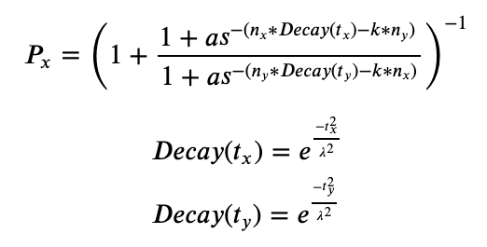
Extended formula
Assumption: The preference of moving to one direction would decrease if ants move along it without making any progress
Decay rate of preference
Short-term memory
Elapsed time without any reward on choosing option x
The higher the elapsed time t_{x}, the lower the positive effect of n_{x} (i.e. number of others chose option x) on the probability of choosing x
Elapsed time without any reward on choosing option y
The higher the elapsed time t_{y}, the lower the negative effect of n_{y} (i.e. number of others chose option y) on the probability of choosing x
** t_{x} and t_{y} are set back to zero when each individual gets rewards or chooses different option
Notes:
Presenter: Jooseok Lee
So, we came up with this extended formula based on the assumption that the preference of moving to one direction would decrease if ants move along it without making any progress
We introduced two concepts, namely decaying rate of preference and short-term memory into the model.
Here, the tx or ty indicate the elapsed time without making progress from the time when ants chose option x or y.
If the tx increases, then the effect of nx or the number of ants already chose option x decreases leading to lower probability of choosing x.

Slide 8
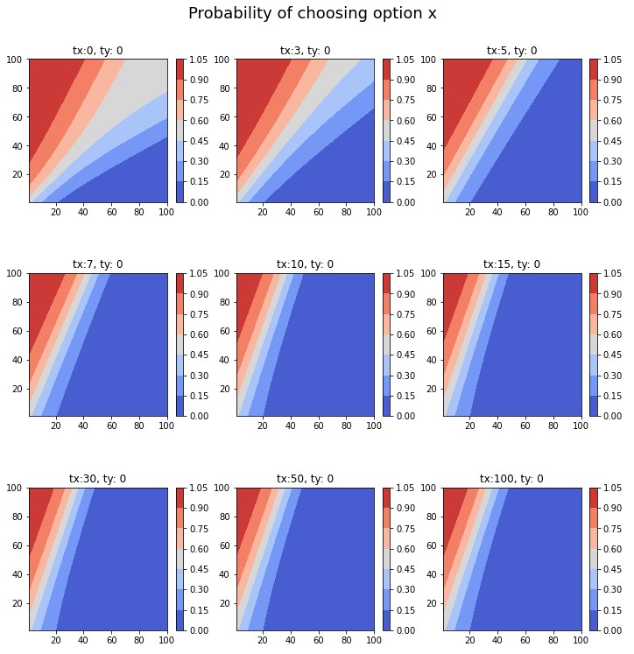
Effect of decaying factor
The probability of choosing option x depending on the number of n_{x} and n_{y} decreases as the value of tx grows.
However, the probability map stops changing after a certain point → Room for improvement
Figure 5. Probability of choosing option x. The region of higher probability shrinks as the value of t_{x} grows.
Notes:
Presenter: Jooseok Lee
Then, we checked whether the new concepts had the expected effect.
Each graph here is a probability map showing the probability of choosing option x depending on the number of other ants who chose option x and option y.
As you can see, as the elapsed time tx increases, the region with high probability or red region gets smaller.
However, we also found that the probability map stops changing after a certain point.
We are trying to solve this issue with different formula.

Slide 9




Simulation
Ants’ decision-making process when they are faced with a bar-shape obstacle
Number of runs: 1000
Number of decision-making steps in each run: 100
Number of ants in a group: 36
Number of options: 2 (i.e., left or right)
Collective movement: Net force of ants in each direction
?
?
Figure 6. Ants are making decisions when they face with a bar-shape obstacle
Notes:
Presenter: Jooseok Lee
With the extended model, we also did a preliminary simulation to check whether the expected behaviors such as sharp turns emerge.
We simulated ant’s decision-making process when they are faced with a bar-shape obstacle during collective transport.
In each step, an individual ant decides to go left or right depending on the extended formula.
When all ants’ decisions are made, the collective movement of the group is calculated by the net force of ants.

Slide 10
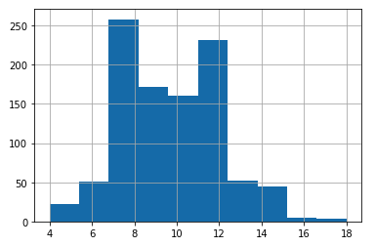
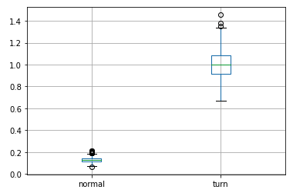
Preliminary results
On average, a group of ants made 9.61 turns out of 100 steps in each simulation run with standard deviation 2.27.
Speed changes when a turn happened were much higher than when ants were moving to one direction → Indicating a sharp turn
Figure 7. Number of turns ants made in each simulation run
Figure 8. Speed changes (Normal movement vs turn)
** Parameters that could show the intended results were chosen
Notes:
Presenter: Jooseok Lee
On average, it was observed that ants made 9.61 turns out of 100 steps in each simulation run.
Also, speed changes when a turn happened was much higher than when ants were moving to one direction, indicating that sharp turns occurred in the simulation.

Slide 11
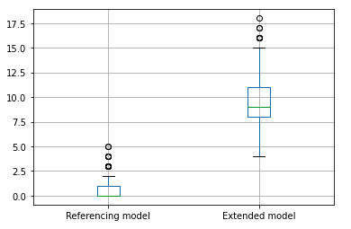
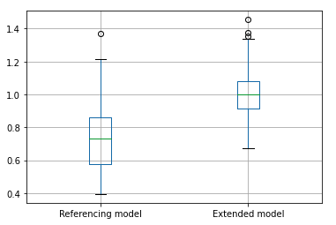
Comparison with the referencing model
The extended model showed higher number of turns and speed changes when a turn happened
Unlike our assumption about the referencing model, however, sharp turns did happen with the referencing model.
Figure 9. Comparison between two models (number of turns)
Figure 10. Comparison between two models (Speed changes)
** Parameters that could show the intended results were chosen
Notes:
Presenter: Jooseok Lee
For further analysis, we compared our model with the referencing model.
The extended model did show higher number of turns and speed changes.
However, it was also observed that sharp turns happened with the referencing model, too, which is in contrast to our assumption.

Slide 12
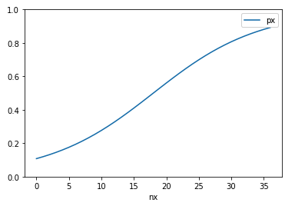
Sharp turns in the referencing model
Unlike our assumption about the referencing model, however, sharp turns did happen with the referencing model.
The interplay between parameters a and s (i.e. the strength of external reasons and social interaction, respectively) could indirectly influence the number of sharp turns occurred during the simulation
When s=1.07 , a=2.5 and n=36, the minimum value of px is 0.11 meaning sharp turns are probable
The interplay between parameter a and s could indirectly influence the number of sharp turns occured
Figure 10. p_{x} depending on n_{x} (Reference model)
Notes:
Presenter: Jooseok Lee
So, we further analyzed the behavior of the referencing model with simulation and found that the interplay between parameters a and s or the strength of external reasons and social interaction could indirectly influence the number of sharp turns occurred during the simulation.
It was somewhat disappointing but we think that our approach has an advantage that we could explicitly control the occurrence of sharp turns.

Slide 13
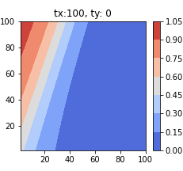
Limitations
Probability map stops changing after a certain point
Possible to stuck in an absorbing state where every ant chooses one side
Planning to try different formula and see what happens
Figure 11. Probability map when t_{x} is 100
Notes:
Presenter: Jooseok Lee
These are the results that we have come up with so far.
Currently, we are trying different formula to prevent a group of ants from getting stuck in an absorbing state where every ant chooses one side indicated by this red circle.

Slide 14
Other things to do
Developing other metrics
Number of steps taken to get to the edge of obstacles with different lengths
Completing prototype for visualization tool using Qt Framework
Notes:
Presenter: Jooseok Lee
Furthermore, we are developing other metrics to evaluate our model, such as the number of steps taken to get to the edge of obstacles with different lengths
Finally, we are working on prototyping a visualization tool using Qt Framework.
Sitong will show the work-in-progress prototype and explain it from now on.

Slide 15
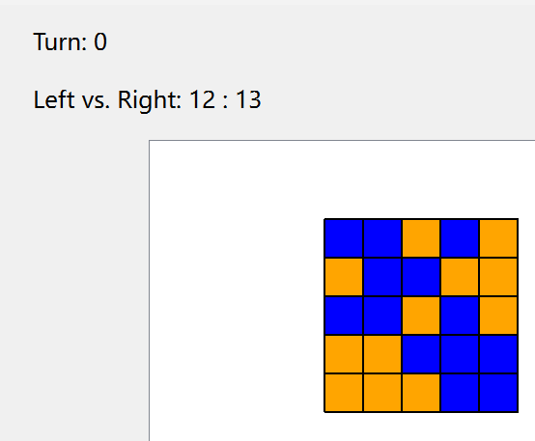
Work-in-progress prototype
Notes:
Presenter: SItong Lu

Slide 16
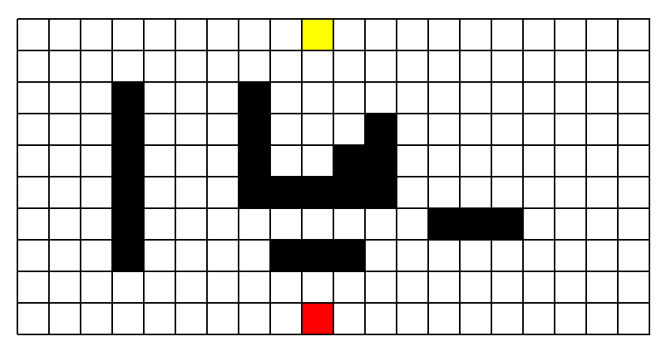
Work-in-progress prototype
Notes:
Presenter: SItong Lu

Slide 17
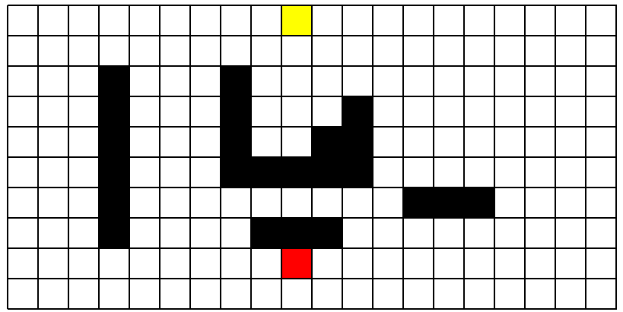
Work-in-progress prototype
Notes:
Presenter: SItong Lu

Slide 18
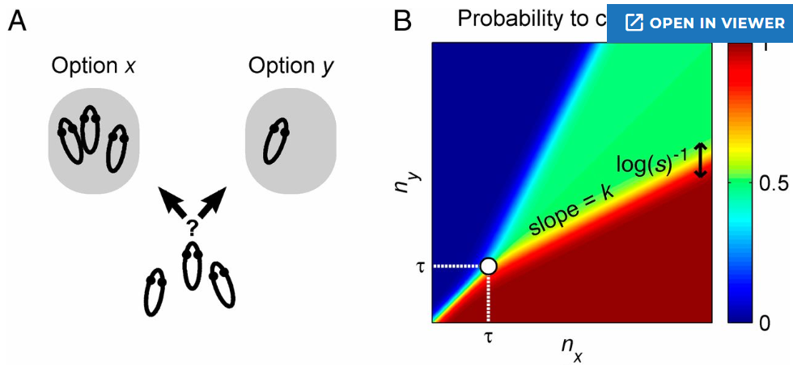
Work-in-progress prototype
Notes:
Presenter: SItong Lu

Slide 19
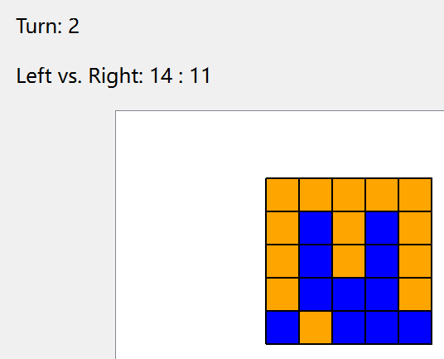
Work-in-progress prototype
Notes:
Presenter: SItong Lu

Slide 20
Work-in-progress prototype
Notes:
Presenter: SItong Lu

Slide 21

Work-in-progress prototype
Notes:
Presenter: SItong Lu

Slide 22
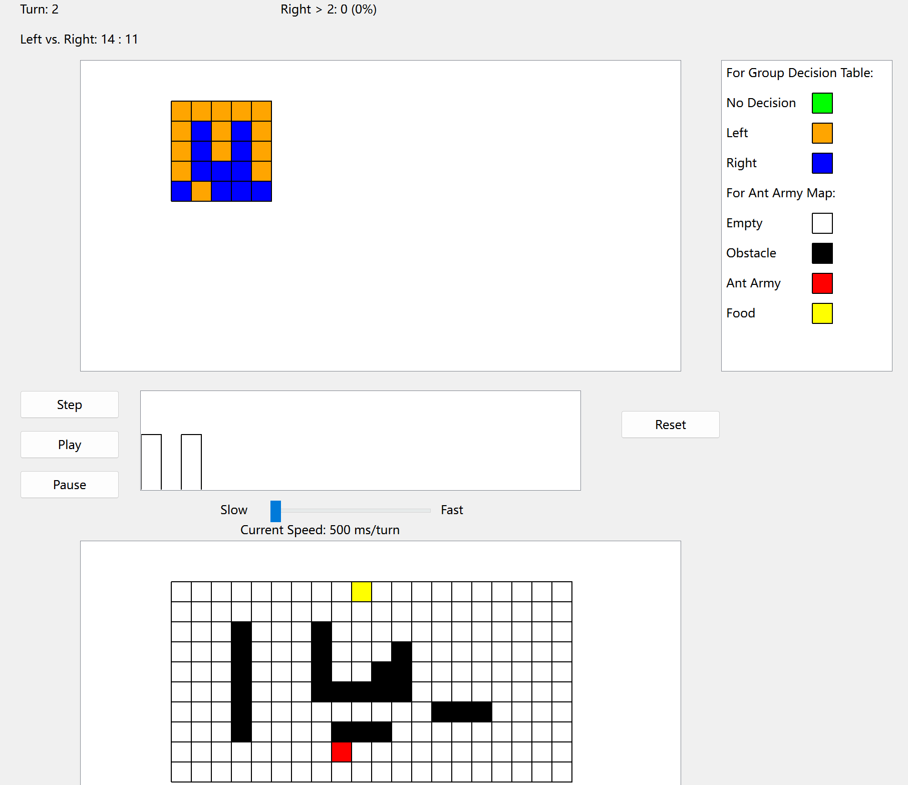
Work-in-progress prototype
Notes:
Presenter: SItong Lu

Slide 23
QnA

